Slide 1
Efficient Early Detection of Malaria for field-based testing in developing countries
Soraya Ngarnim, Viraj Boreda, Kirthi Kumar
Padhu Seshaiyer, Nathalia Peixoto (Faculty Mentors)

Slide 2
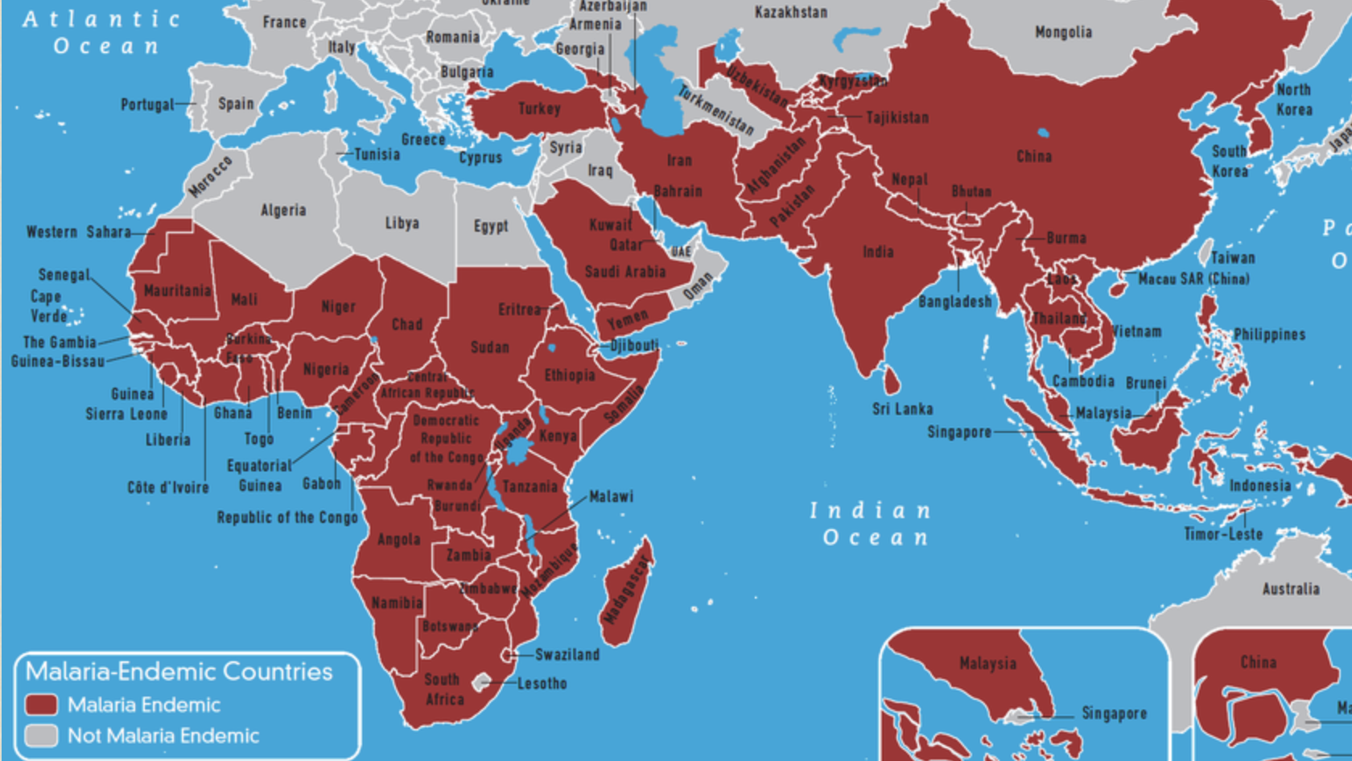
Motivation
Access to malaria detection testing in endemic areas in developing countries
Identifying most efficient, accurate and cost-effective

Slide 3
Project Activities
Algorithm Development
Dataset Manipulation
Device Development
App Development
Field-Testing
Training

Slide 4
Project Plan
Verification and Validation of Deep Learning for Malaria
Malaria parasite in image of blood cell through feature extraction techniques for image segmentation algorithm and machine learning through various classifiers (1 week)
Compare and contrast various image segmentation/machine learning algorithms (Review Paper – Tables IV – VIII) – ASSIP Project Goal (4 weeks)
Validate more benchmarks (TBD)
National Library of Medicine (NLM) dataset of healthy and infected blood smear images
Laboratory diagnosis of Malaria (CDC)
Repeat for dataset with Malaria test for Saliva-based rapid test (Collaborative effort) - Towards goal for OSCAR
Use design thinking ideas to create a field-usable device for malaria diagnosis using URINE that can plug into a phone activated through an APP
Chemistry - Protein, Electronics and CS – Building the device and codes
Publish a Paper and give research talks at national meetings

Slide 5
Machine Learning Progress

Slide 6
ML Overview
Step 1
Download the dataset
Step 3
Modify the images/Image processing
Step 5
Apply various machine learning techniques
Step 2
Install and import necessary libraries
Step 4
Split training/testing data

Slide 7
Viraj’s Work
Previous Progress
Downloaded the Dataset
Installed Packages and Imported Libraries
Using OpenCV
Convert images to grayscale
Apply Gaussian Blur
Extract contours
Find areas of contours
Since Last Time...
Fixed data parsing error
Completed machine learning portion

Slide 8
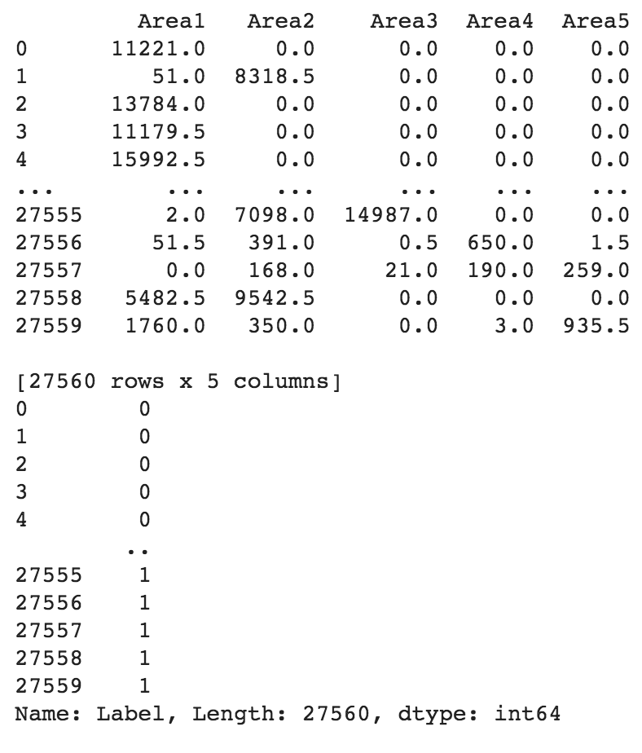
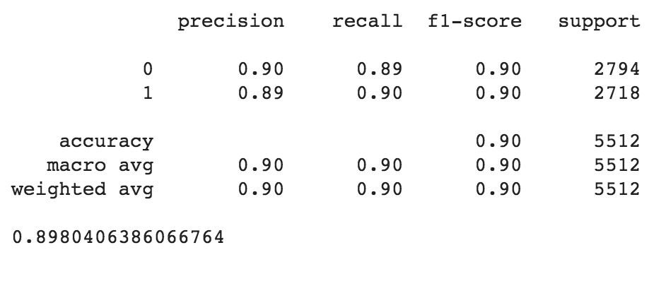
Viraj’s Work (cont.)

Slide 9
Innovation
False positivity in blood test may occur at a rate of 2.2% to 13%
Factors: rheumatoid factor, hepatitis C, toxoplasmosis, dengue, Chagas disease ect.
High RF factors tend to be associated with False positivity
Solution
Develop an algorithm that:
takes into account stage classification for the disease for early detection
takes into account High RF in to reduce false positive malaria test

Slide 10
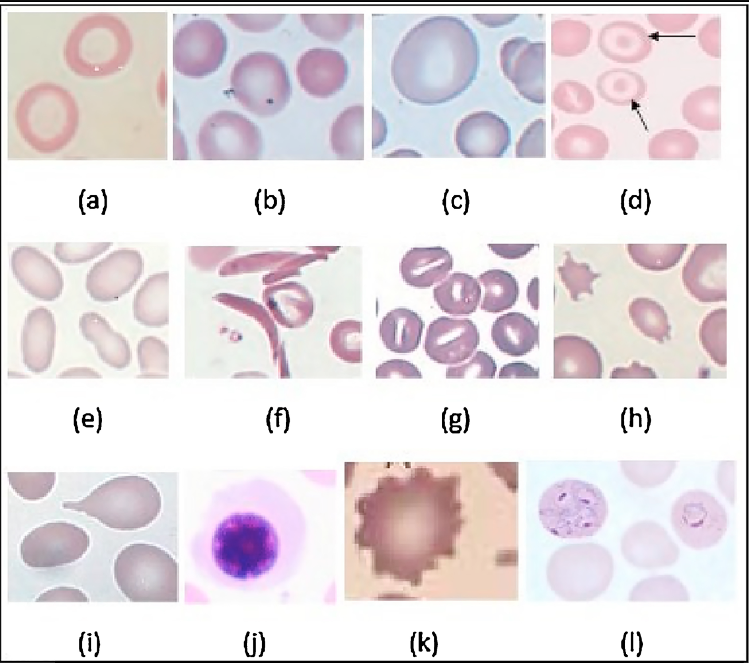
Next steps
Run a confusion matrix for different images of different factors
Notes:
(a) Microcyte, (b) Spherocytosis, (c) Macrocyte, (d) Target cell, (e) Elliptocytosis, (f) Sickle cell, (g) Stomatocytosis, (h) Fragmented cell, (i) Tear drop, (j) NRBC, (k) Burr cell, (l) Malaria.

Slide 11
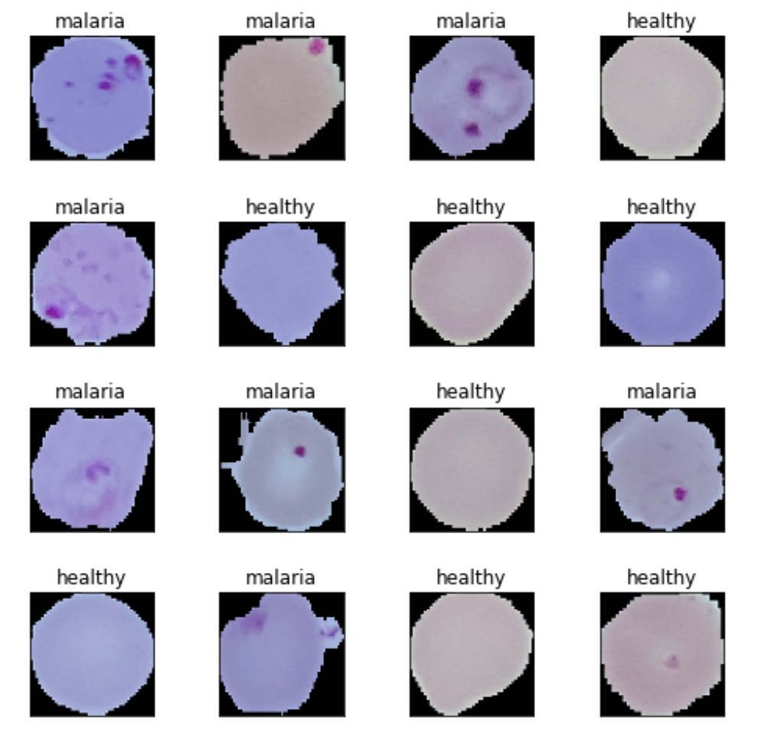
Kirthi’s Work
Previous Progress
Downloaded the Dataset
Installed Packages and Imported Libraries
Resized Images
Used Tensorflow to build CNN
Almost trained CNN
Since Last Time…
Implement code in Colab to access TPU
Finish training CNN
Collect Learning Data
Save Model

Slide 12
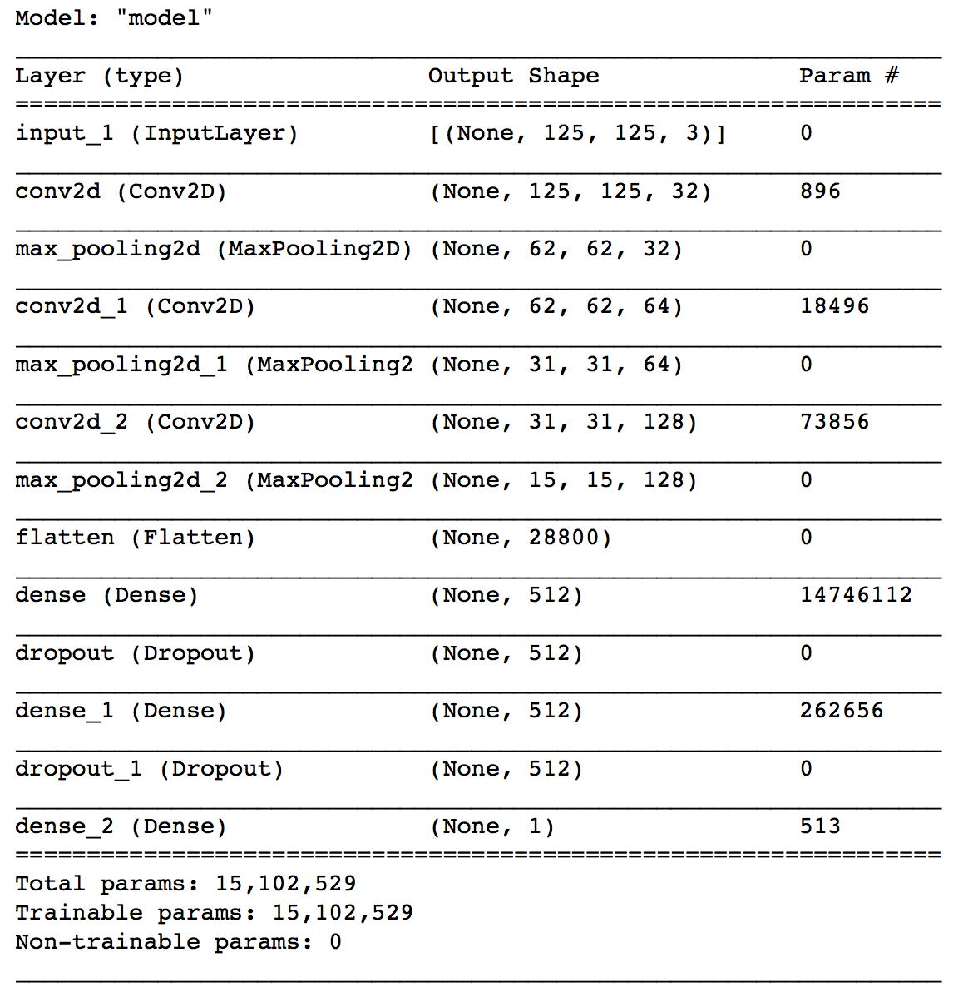
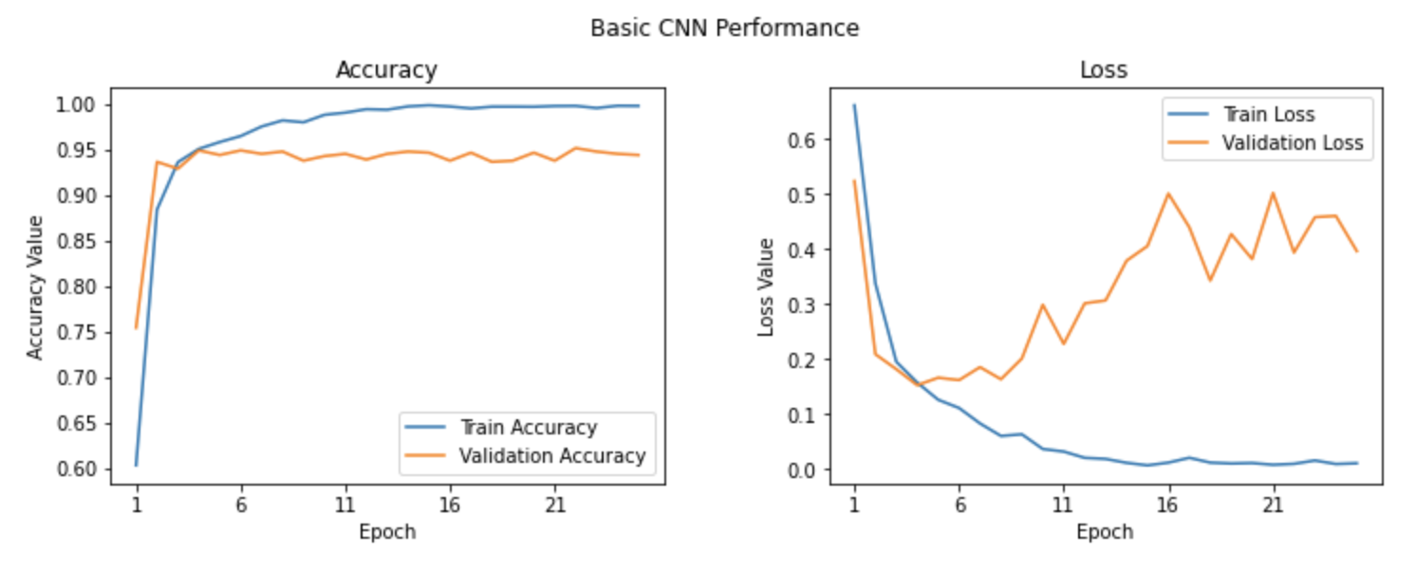
Kirthi’s Work (cont.)

